Slide 1

PolicyGRID: Acting to Understand, Understanding to Act
NeurIPS 2025 Workshop on Embodied World Models for Decision Making

Slide 2

Correlation vs Causation
Notes:
When Tony Stark activates his Ironman suit’s thrusters, he is confident they will lift him — not because he has merely observed it before, but because he understands the cause–effect mechanism powering the system. Humans (and billionaires in iron suits) rely on causal reasoning to act reliably in the world. Most AI systems, however, do not. Current approaches excel at correlation-based pattern recognition — e.g., learning that lights are usually on when a switch is flipped — but lack the capacity to reason that flipping the switch causes the light to turn on. While correlation may suffice for passive prediction, it fails once an agent must act in dynamic environments. In embodied domains such as building control, correlation-driven policies often yield suboptimal or unstable outcomes.

Slide 3
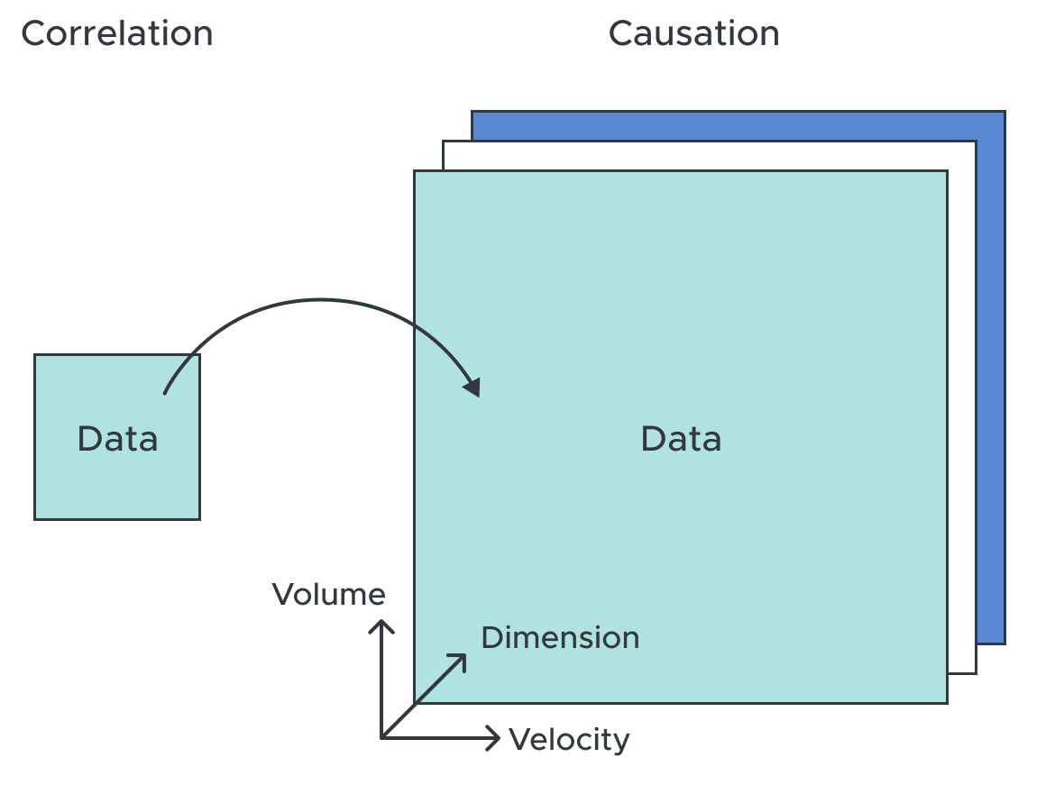
Correlation vs Causation
correlation != causation
models fail when agents intervene
current systems either:
ignore causal structures
treat causality as an offline pre-processing step
Notes:
Embodied agents must reason causally about how their actions affect the environment. Unlike passive observers, agents that act in the world require internal models that predict the consequences of interventions. Correlational models fail when agents intervene because correlation does not imply causation. This fundamental limitation constrains current embodied AI systems to reactive behaviors rather than principled, goal-directed action, despite theoretical work showing that general agents require world models for multi-step generalization. Current approaches to embodied decision-making either ignore causal structure entirely or treat causal discovery as a separate preprocessing step. This disconnect prevents embodied agents from integrating causal reasoning directly into their decision-making processes. Discovering causal structure alone is 33 insufficient; the structure must be leveraged for principled policy generation.

Slide 4

Why Causality Matters
Prediction ≠ Understanding
Correlations describe what tends to happen
But actions change the world — correlations break under intervention
Real-world systems need stability, transferability, and control
Goal: move from seeing patterns → understanding mechanisms

Slide 5
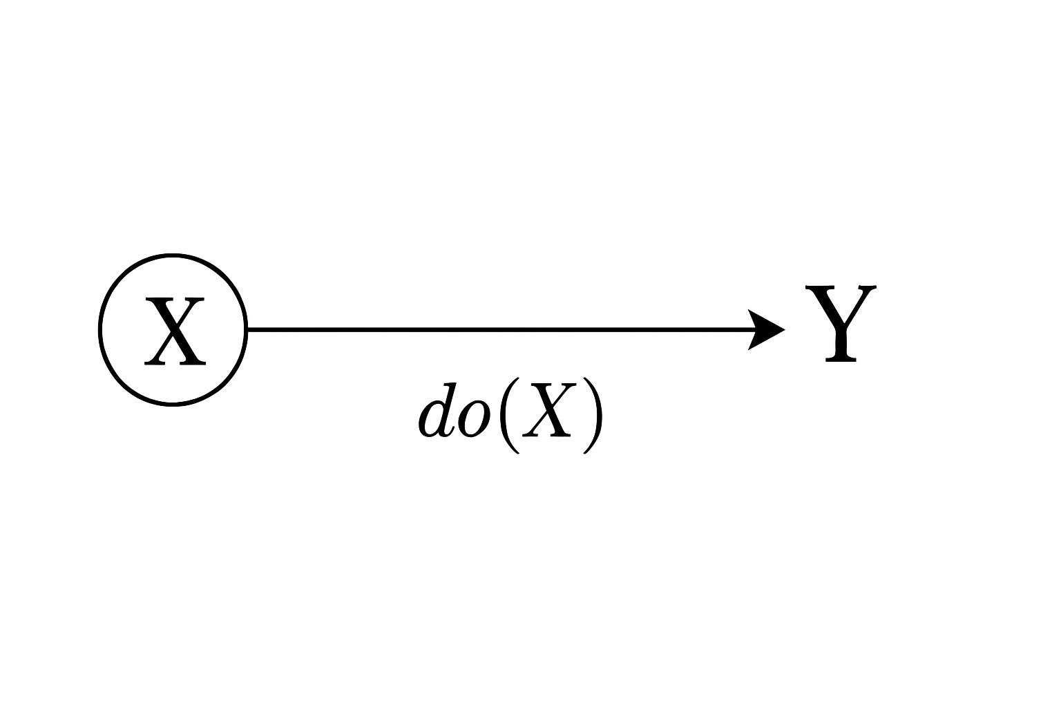
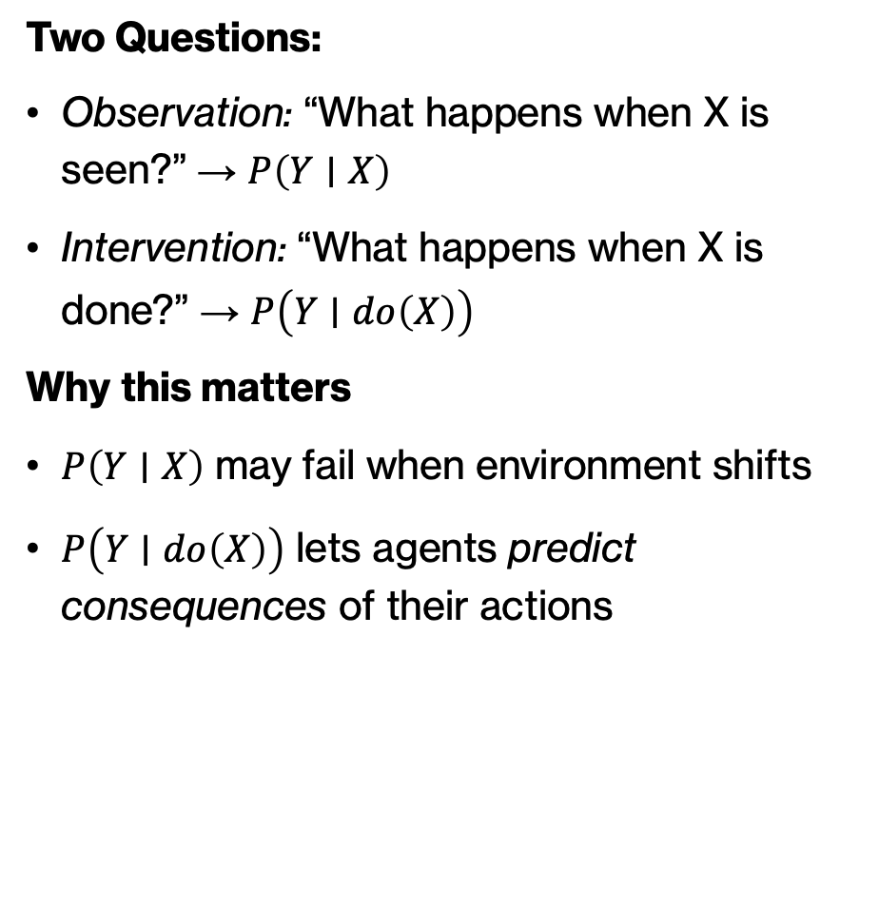
From Observation to Intervention
Two Questions:
Observation: “What happens when X is seen?” → $P\left(Y∣X\right)$
Intervention: “What happens when X is done?” → $P\left(Y∣do\left(X\right)\right)$
Why this matters
$P\left(Y∣X\right)$ may fail when environment shifts
$P\left(Y∣do\left(X\right)\right)$ lets agents predict consequences of their actions

Slide 6
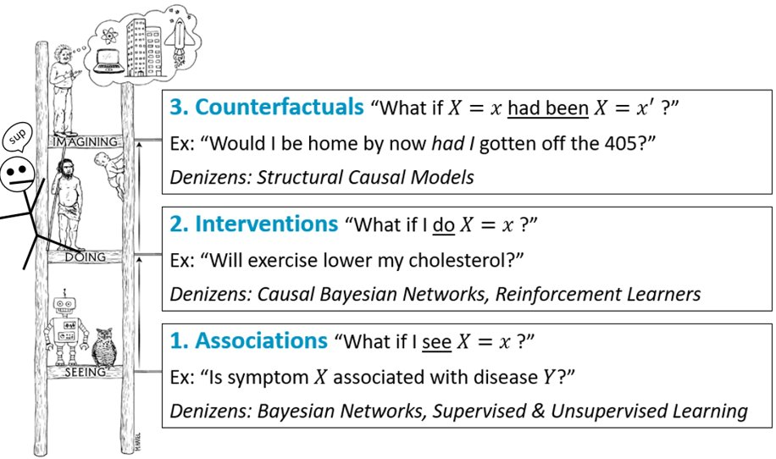
The Causal Ladder
Levels of Reasoning (Pearl, 2019)
PolicyGRID operates at 2–3
- Learns how actions change outcomes
- Uses causal understanding to design better control policies
Notes:
Levels of Reasoning (Pearl, 2019)
Association: Seeing — $P\left(Y∣X\right)$
Intervention: Doing — $P\left(Y∣do\left(X\right)\right)$
Counterfactual: Imagining — “What if X had been different?”
PolicyGRID operates at Level 2–3
Learns how actions change outcomes
Uses causal understanding to design better control policies

Slide 7
Why PolicyGRID
Bridging Understanding and Action
Existing agents → ignore causality or treat it as offline pre-processing
PolicyGRID: → discovers causal structure → validates interventions → translates causal knowledge into adaptive policies
Acting to Understand, Understanding to Act

Slide 8
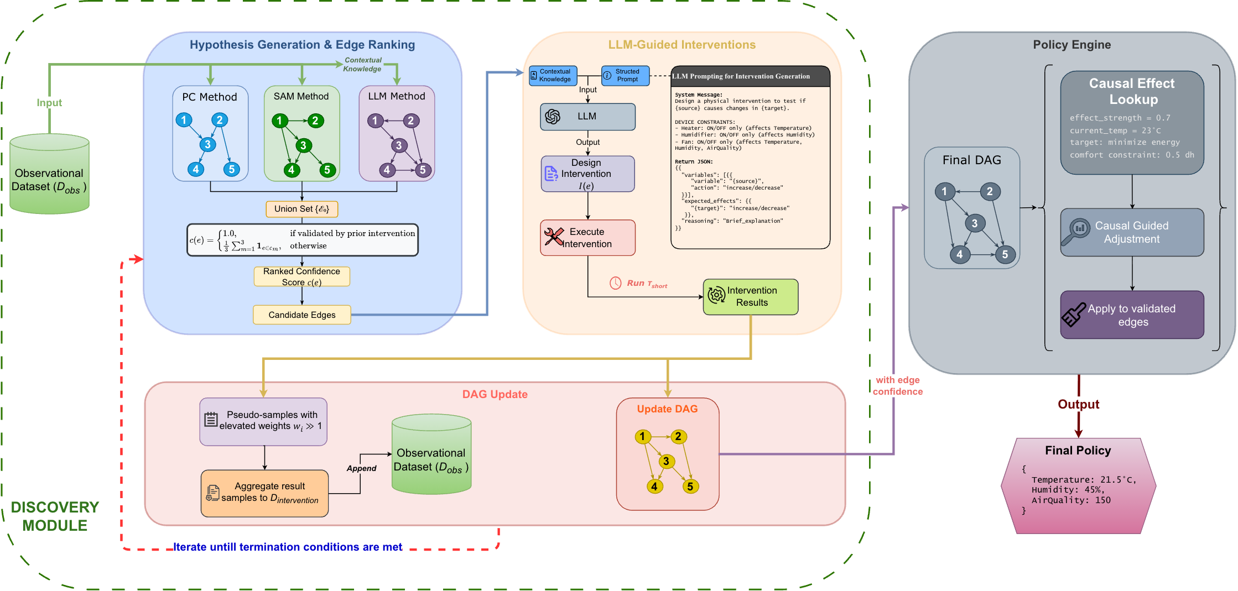
PolicyGRID
Discovering causal structure from data
Validating causal relationships
Translating causal knowledge into policies.
Notes:
The framework addresses three key requirements for embodied causal reasoning: (1) discovering causal structure from observational and interventional data, (2) validating causal relationships through 44 targeted experiments, and (3) translating causal knowledge into operational policies. By integrating these components, POLICYGRID enables agents to reason about the consequences of their actions rather than merely react to correlations. This work extends the embodied world model discourse by demonstrating how causal reasoning can be embedded directly within the policy loop, moving beyond the latent dynamics models of Hafner et al. [2020] and the meta-learning approaches of Finn et al. [2017] toward principled interventional reasoning [Battaglia et al., 2016, Wu et al., 2015].
Contributions. We establish three insights for embodied causal reasoning. First, interventions serve dual purposes: control actions simultaneously manipulate the environment and refine the agent’s causal understanding. POLICYGRID treats each action as both a policy decision and an experiment that updates internal world models. Second, causal discovery need not precede control but can occur within it. Agents probe their environment to resolve structural uncertainty while optimizing for objectives, collapsing the traditional separation between learning and acting. Third, policies grounded in validated causal structure outperform correlation-based alternatives in multi-objective settings. Empirical validation demonstrates F1 = 0.89 for causal recovery and 2.8× hypervolume improvement over correlation-based methods, confirming that causal world models provide a more reliable foundation for multi-objective control than statistical dependencies alone.

Slide 9
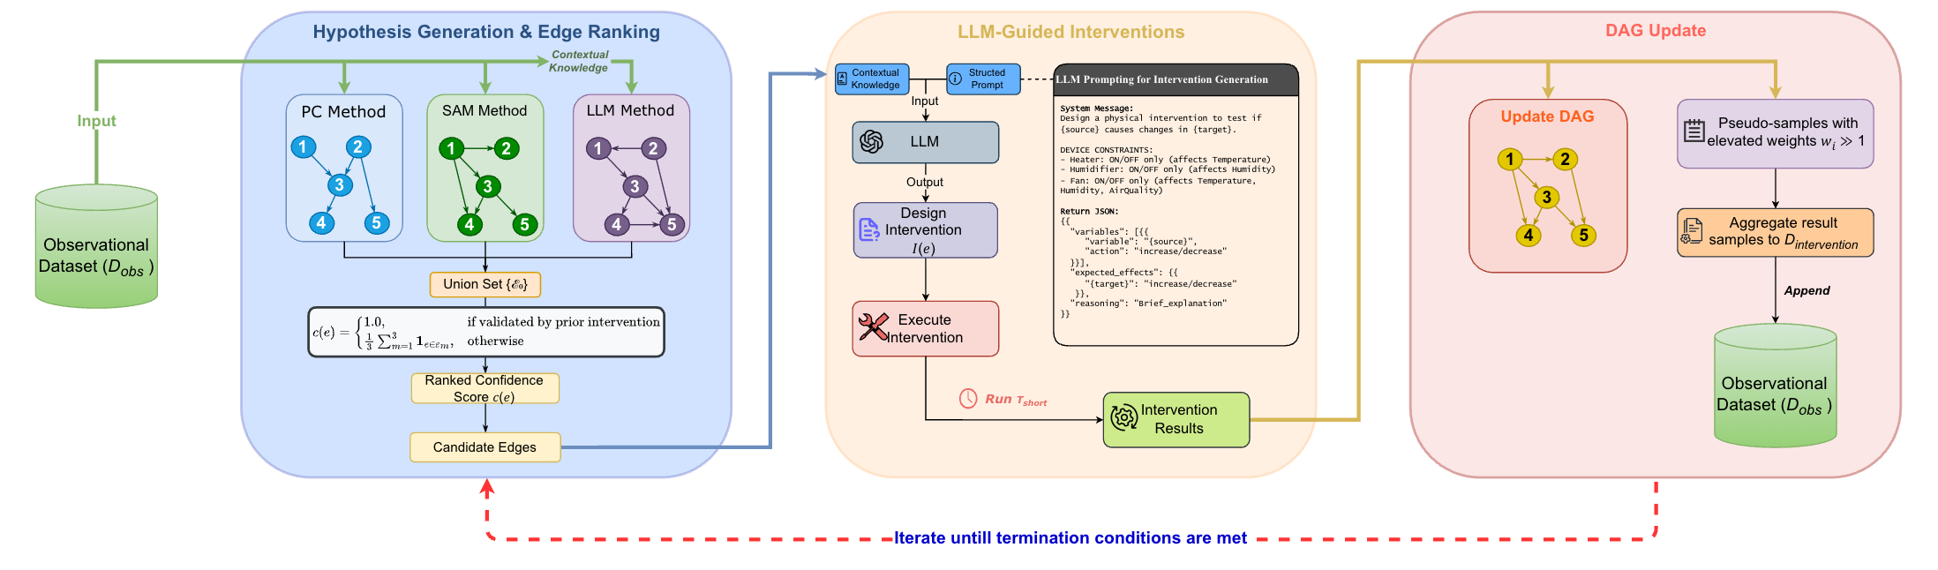
Discovery Module

Slide 10
Discovery Module: Hypothesis Generation
3 generators: PC, SAM, LLM
Hypothesis edge union + scored ranking
Start iterative testing in ascending order of confidence scores

Slide 11
Stage 1: Initialization
1. Generate three hypothesis DAGs (PC, SAM, LLM algorithms)
2. Extract union of all edges across methods
3. Rank edges by method agreement (low → high confidence):
- Low confidence: edge appears in 1 method
- Medium confidence: edge appears in 2 methods
- High confidence: edge appears in 3 methods

Slide 12
Discovery Module: Interventions
Intervention on each edge
LLM designs the intervention to be executed
Notes:
the effect_size ratio has:
Lower bound: 0 (when source_change ≤ 0.001 or target doesn't change)
Upper bound: Unbounded theoretically, but confidence calculation caps at 1.0 via confidence = min(1.0, avg_effect * consistency_factor)
Practical range: Typically 0 to ~10, since very large ratios (e.g., target_change >> source_change) indicate either measurement issues or extremely sensitive relationships that get filtered by consistency checks

Slide 13
Stage 2: Iterative Testing Loop (repeat until max iterations or all validated)
For each edge in ranked order (starting with lowest confidence):
# Initial Testing Phase
FOR i = 1 to 3:
intervention_value = design_intervention(source_variable)
result = perform_intervention(source, intervention_value)
# Measure effect
source_change = |result.post[source] - result.pre[source]|
target_change = |result.post[target] - result.pre[target]|
IF target_change > 0.001:
effect_size[i] = target_change / source_change
ELSE:
effect_size[i] = 0
# Decision Point
IF no effect detected in 3 consecutive tests:
DISCARD edge permanently
CONTINUE to next edge
# Extended Testing Phase (if initial effect detected)
ELSE:
FOR i = 4 to 10: # Collect 5-10 additional data points
perform_intervention()
calculate_effect_size[i]
# Calculate validation metrics
avg_effect = mean(effect_sizes)
variation = std(effect_sizes)
consistency_factor = 1.0 / (1.0 + variation/avg_effect)
confidence = min(1.0, avg_effect × consistency_factor)
# Validation Decision
IF confidence ≥ 0.5 AND variation < 2×avg_effect:
VALIDATE edge
ADD intervention data to training dataset
validated_edges.add(edge)
ELSE:
DISCARD edge
Notes:
Consistency factor penalizes edges with erratic effects. It measures how reliable the relationship is across multiple tests:
High variation relative to average effect → low consistency_factor → reduces confidence
Formula: 1.0 / (1.0 + variation/avg_effect)
If variation equals avg_effect, consistency_factor = 0.5 (50% penalty)
If variation is negligible, consistency_factor approaches 1.0 (no penalty)
---
Confidence combines effect magnitude with consistency:
confidence = avg_effect × consistency_factor
Strong effect + consistent results → high confidence → edge validated
Strong effect + inconsistent results → lower confidence → edge discarded
Weak effect (regardless of consistency) → low confidence → edge discarded
The threshold is 0.5, meaning you need either: (1) moderate effect with perfect consistency, or (2) strong effect tolerating some variation. This prevents validating spurious relationships that occasionally show large effects but aren't reproducible.
---
The effect_size itself is unbounded - it's just a raw ratio that can theoretically be any positive number. For example:
Small source change (0.01) with large target change (10) → effect_size = 1000
Moderate changes (5/2) → effect_size = 2.5
However, confidence (which determines edge validation) is capped at 1.0:
consistency_factor = 1.0 / (1.0 + variation / max(avg_effect, 0.001))
confidence = min(1.0, avg_effect * consistency_factor)
This means:
An edge with avg_effect = 0.8 and perfect consistency → confidence = 0.8
An edge with avg_effect = 5.0 and perfect consistency → confidence = 1.0 (capped)
An edge with avg_effect = 5.0 but high variation → confidence < 1.0 (consistency penalty applies)
So while massive effect_sizes are possible, they don't provide extra validation credit beyond reaching confidence = 1.0. The cap prevents overly sensitive edges from dominating the validation process.

Slide 14
Discovery Module: DAG Update
If intervention effects > threshold:
Continue testing and append intervention data to dataset
Else, discard edge
Update final DAG with validated edge
Repeat until:
all candidate edges are evaluated
Tmax interventions is reached
learned DAG converges

Slide 15
Stage 3: DAG Regeneration (after each validated edge)
IF any edges validated in iteration:
# Update training data
training_data = original_data + intervention_results
# Regenerate hypotheses with new data
PC_dag = run_PC_algorithm(training_data)
SAM_dag = run_SAM_algorithm(training_data)
LLM_dag = run_LLM_algorithm(training_data)
# Re-rank remaining edges
union_edges = (PC ∪ SAM ∪ LLM) - validated_edges
re_rank_by_method_agreement(union_edges)
# Restart testing from lowest confidence edge
GOTO Stage 2
Notes:
The process terminates when either all edges are processed or SHD (Structural Hamming Distance) reaches 0 (perfect match with ground truth).

Slide 16
Stage 4: Final DAG Construction
# Build DAG from validated edges only
G = DirectedGraph()
G.add_nodes(all_variables)
# Add edges in confidence order, maintaining acyclicity
FOR edge IN sorted(validated_edges, by=confidence, descending):
G.add_edge(edge)
IF creates_cycle(G):
G.remove_edge(edge)
LOG("Edge discarded due to cycle")
RETURN G

Slide 17
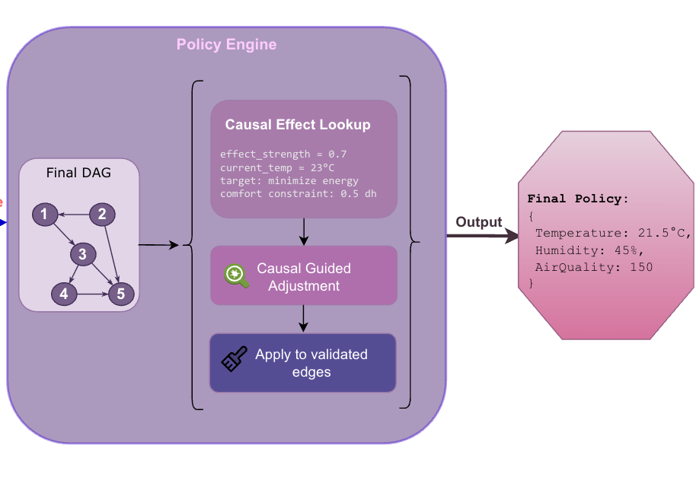
Policy Engine
Validated DAG → world model
For each edge:
Get effect_strength from past intervention data
Adjust controls accordingly
Apply necessary constraints to all adjustments
Return final policy
Notes:
Evaluate each edge vis-à-vis the objective based on intervention data from Discovery Module
Causal Optimization Step-by-Step
Initialize policy with current_state values (copy of current variable settings)
Iterate through each validated edge (source → target) in the DAG
For each edge:
Extract effect_strength = absolute value of correlation between source and target
Check what the target variable represents
If target is energy-related:
Find energy objectives in the objectives dict
Calculate reduction: 0.4 × effect_strength × objective_weight × comfort_limit
Get constraint bounds for source variable
Update: policy[source] = clip(policy[source] - reduction, min, max)
Justification:
0.4 coefficient: Aggressive but safe reduction factor (grid search)
effect_strength (0.75): Strong causal effect means more confidence in adjustment
weight (0.4): Energy is 40% of total objectives—proportional adjustment
comfort_limit (0.8): High value means we still prioritize comfort, so reduce energy savings
Subtract: Lower temperature → lower energy consumption (assuming positive correlation)
Why this works: Temperature causally drives energy use (e.g., HVAC). Lowering temp reduces consumption, scaled by how much we care about energy vs. comfort.
If target is satisfaction/comfort-related:
Find satisfaction objectives in the objectives dict
Calculate boost: 0.3 × effect_strength × objective_weight × (2.0 - comfort_limit)
Get constraint bounds for source variable
Update: policy[source] = clip(policy[source] + boost, min, max)
Justification:
0.3 coefficient: Moderate boost factor (less aggressive than energy)
effect_strength (0.65): Moderate causal effect on satisfaction
weight (0.6): Satisfaction is 60% of objectives—major priority
(2.0 - comfort_limit): Inverted comfort_limit amplifies adjustment when comfort_limit is LOW
If comfort_limit = 0.3 → (2.0 - 0.3) = 1.7 (large boost)
If comfort_limit = 0.8 → (2.0 - 0.8) = 1.2 (small boost)
Add: Higher temperature → higher satisfaction (assuming positive correlation)
Why this works: When comfort_limit is low (energy savings mode), we're willing to sacrifice satisfaction. When high (comfort mode), we boost satisfaction more aggressively.
Apply comfort-specific adjustments based on comfort_limit targets (additional fine-tuning beyond the edge-based adjustments)
Return optimized policy with adjusted variable values
The key insight: validated causal edges directly determine how much to adjust each control variable to optimize outcomes, with adjustment magnitude proportional to causal effect strength.

Slide 18
Mock Example: Causal Optimization
Step 1: Initialize (current setpoints)
policy = {'Temperature’: 23.5, 'Humidity’: 46.0}
Step 2: Edge - Temperature → EnergyConsumption
effect_strength = 0.82
reduction = 0.4 × 0.82 × 0.4 × 0.7 = 0.092
# Convert to temperature change: 0.092 × (30 - 18) = 1.1°C
policy['Temperature'] = clip(23.4 - 1.1, 18.0, 30.0) = 22.3 #°C
Step 3: Edge - Temperature → OverallSatisfaction
effect_strength = 0.68
boost = 0.3 × 0.68 × 0.6 × (2.0 - 0.7) = 0.159
# Convert to temperature change: 0.159 × 12 = 1.9°C
policy['Temperature'] = clip(22.3 + 1.9, 18.0, 30.0) = 24.2 #°C
Step 4: Edge - Humidity → OverallSatisfaction
effect_strength = 0.45
boost = 0.3 × 0.45 × 0.6 × 1.3 = 0.105
# Convert to humidity change: 0.105 × (70 - 30) = 4.2%
policy['Humidity'] = clip(46.0 + 4.2, 30.0, 70.0) = 50.2 #%
Return Optimized Policy {'Temperature’: 24.2, 'Humidity’: 50.2}
Validated DAG
Temperature → EnergyConsumption (correlation: 0.82)
Temperature → OverallSatisfaction (correlation: 0.68)
Humidity → OverallSatisfaction (correlation: 0.45)
Input Parameters
objectives = {
'energyconsumption': {'target': 20.0, 'weight': 0.4},
'overallsatisfaction': {'target': 80.0, 'weight': 0.6}
}
constraints = {
'Temperature’: (18.0, 30.0), #°C
'Humidity’: (30.0, 70.0), #%
'comfort_limit': 0.7
}
current_state = {
'Temperature’: 23.4, #°C
'Humidity’: 46.0, #%
'EnergyConsumption': 28.0, #kWh
'OverallSatisfaction': 72.0 #%
}
Notes:
Effect strength is the absolute value of the correlation (Pearson correlation) between source and target variables, extracted from the dataset and DAG
Simple & Fast: Direct measure of linear relationship strength, computed efficiently
Normalized: Always [-1, 1], making effects comparable across different variable scales
Works for validated edges: Since edges are proven causal through interventions, correlation now reflects true causal effect (not spurious) -- These edges were validated through interventions, so correlation here approximates actual causal effect size
The policy engine works in normalized [0,1] space, so:
0.092 is the normalized adjustment
(30 - 18) = 12°C is the physical temperature range
0.092 × 12 = 1.1°C is the actual temperature change
Think of 0.092 as "9.2% of the full temperature range" = 9.2% of 12°C = 1.1°C

Slide 19
CAUSAL OPTIMIZATION (CORE ALGORITHM)
# POLICY OPTIMIZATION ENTRY POINT
FUNCTION optimize_policy(objectives, constraints, current_state, n_candidates):
comfort_limit = constraints['comfort_limit'
IF validated_edges is EMPTY:
RETURN baseline_policy(objectives, constraints, current_state)
ELSE:
RETURN causal_optimization(objectives, constraints, current_state, comfort_limit)
# CAUSAL OPTIMIZATION (CORE ALGORITHM)
FUNCTION causal_optimization(objectives, constraints, current_state, comfort_limit):
# Step 1: Initialize policy with current state
policy = COPY(current_state)
# Step 2: Process each validated causal edge
FOR EACH (source, target) IN validated_edges:
IF source NOT IN policy:
CONTINUE
# Step 3: Get effect strength
effect_strength = ABS(causal_effects[(source, target)])
# Step 4: Apply energy optimization
IF 'energy' IN LOWERCASE(target):
FOR EACH (outcome, obj) IN objectives:
IF 'energy' IN LOWERCASE(outcome):
# Calculate reduction
reduction = 0.4 × effect_strength × obj['weight'] × comfort_limit
# Apply with constraints
min_val, max_val = constraints[source]
policy[source] = CLIP(policy[source] - reduction, min_val, max_val)
# Step 5: Apply comfort optimization
ELSE IF 'satisfaction' IN LOWERCASE(target) OR 'comfort' IN LOWERCASE(target):
FOR EACH (outcome, obj) IN objectives:
IF 'satisfaction' IN LOWERCASE(outcome):
# Calculate boost
boost = 0.3 × effect_strength × obj['weight'] × (2.0 - comfort_limit)
# Apply with constraints
min_val, max_val = constraints[source]
policy[source] = CLIP(policy[source] + boost, min_val, max_val)
# Step 6: Return optimized policy
RETURN PolicyResult(
action_plan = policy, predicted_outcomes = PREDICT_OUTCOMES(policy), confidence = CALCULATE_CONFIDENCE(),
cost = CALCULATE_COST(), expected_improvement = CALCULATE_IMPROVEMENT(), reasoning = GENERATE_REASONING())

Slide 20
Experiments
Causal Structure Recovery
tested on 6 progressively
compared against 10 representative methods
SHD, F1, precision-recall, cost/risk
Embodied Control Performance
tested in 4 embodied control scenarios
compared against 3 baselines
2 complimentary evaluation perspectives

Slide 21
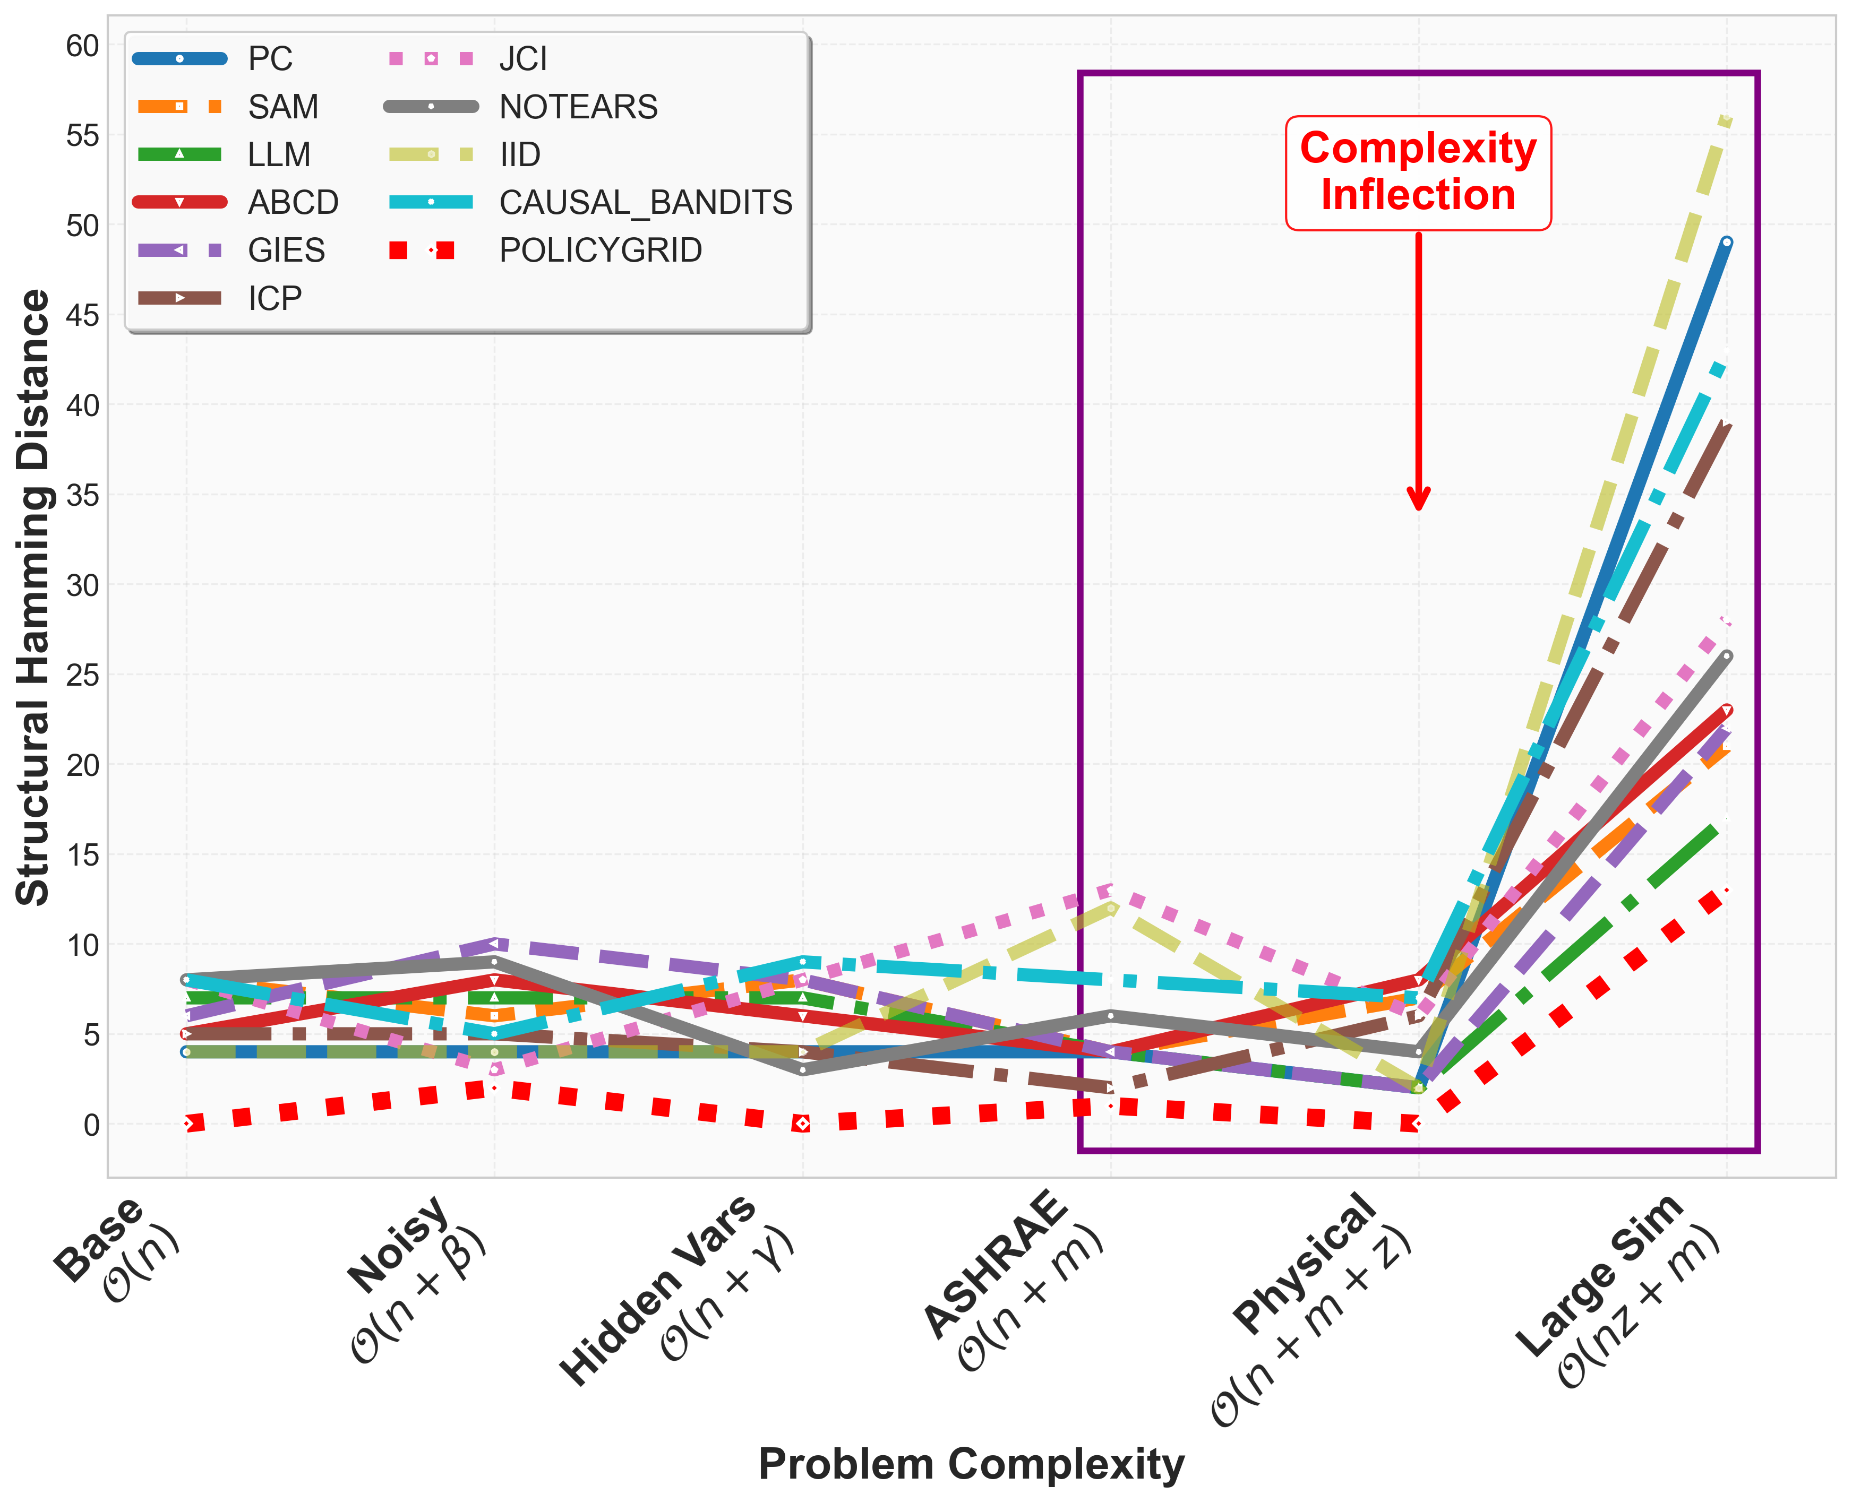
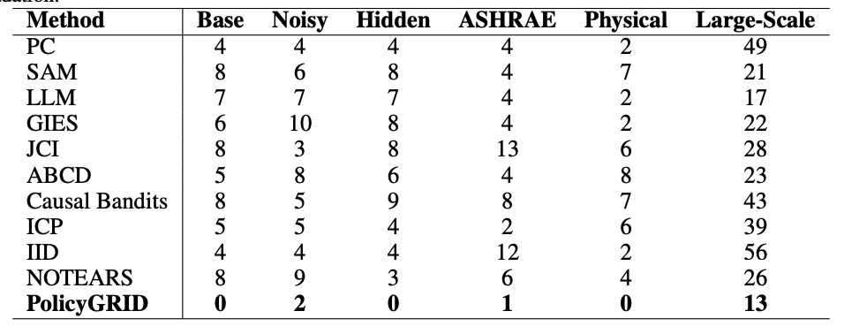
Results: Causal World Model Fidelity
PolicyGRID has lowest SHD across all setups
Baselines degrade with complexity
Notes:
Figure 2 and Table 1 report Structural Hamming Distance (SHD) between learned and ground truth graphs across six setups. POLICYGRID achieves the lowest SHD in all cases, with exact recovery in Base, Hidden-Variable, and Physical (SHD = 0), and low error in Noisy (2), ASHRAE (1), and Large-Sim (13). Baselines varied in accuracy. PC achieved relatively low SHD in simpler setups (Base: 4, Physical: 2) but degraded under complexity (Large-Sim: 49). IID and ABCD followed similar trends, reaching SHD of 56 and 53 in Large-Sim. SAM, GIES, and NOTEARS generally produced higher errors across all setups. Overall, SHD increased with setup complexity, especially beyond the Physical case, reflecting the difficulty of recovering structure in larger and noisier systems. By comparison, POLICYGRID maintained lower SHD throughout, indicating that iterative interventions and physical priors improved robustness across conditions.

Slide 22
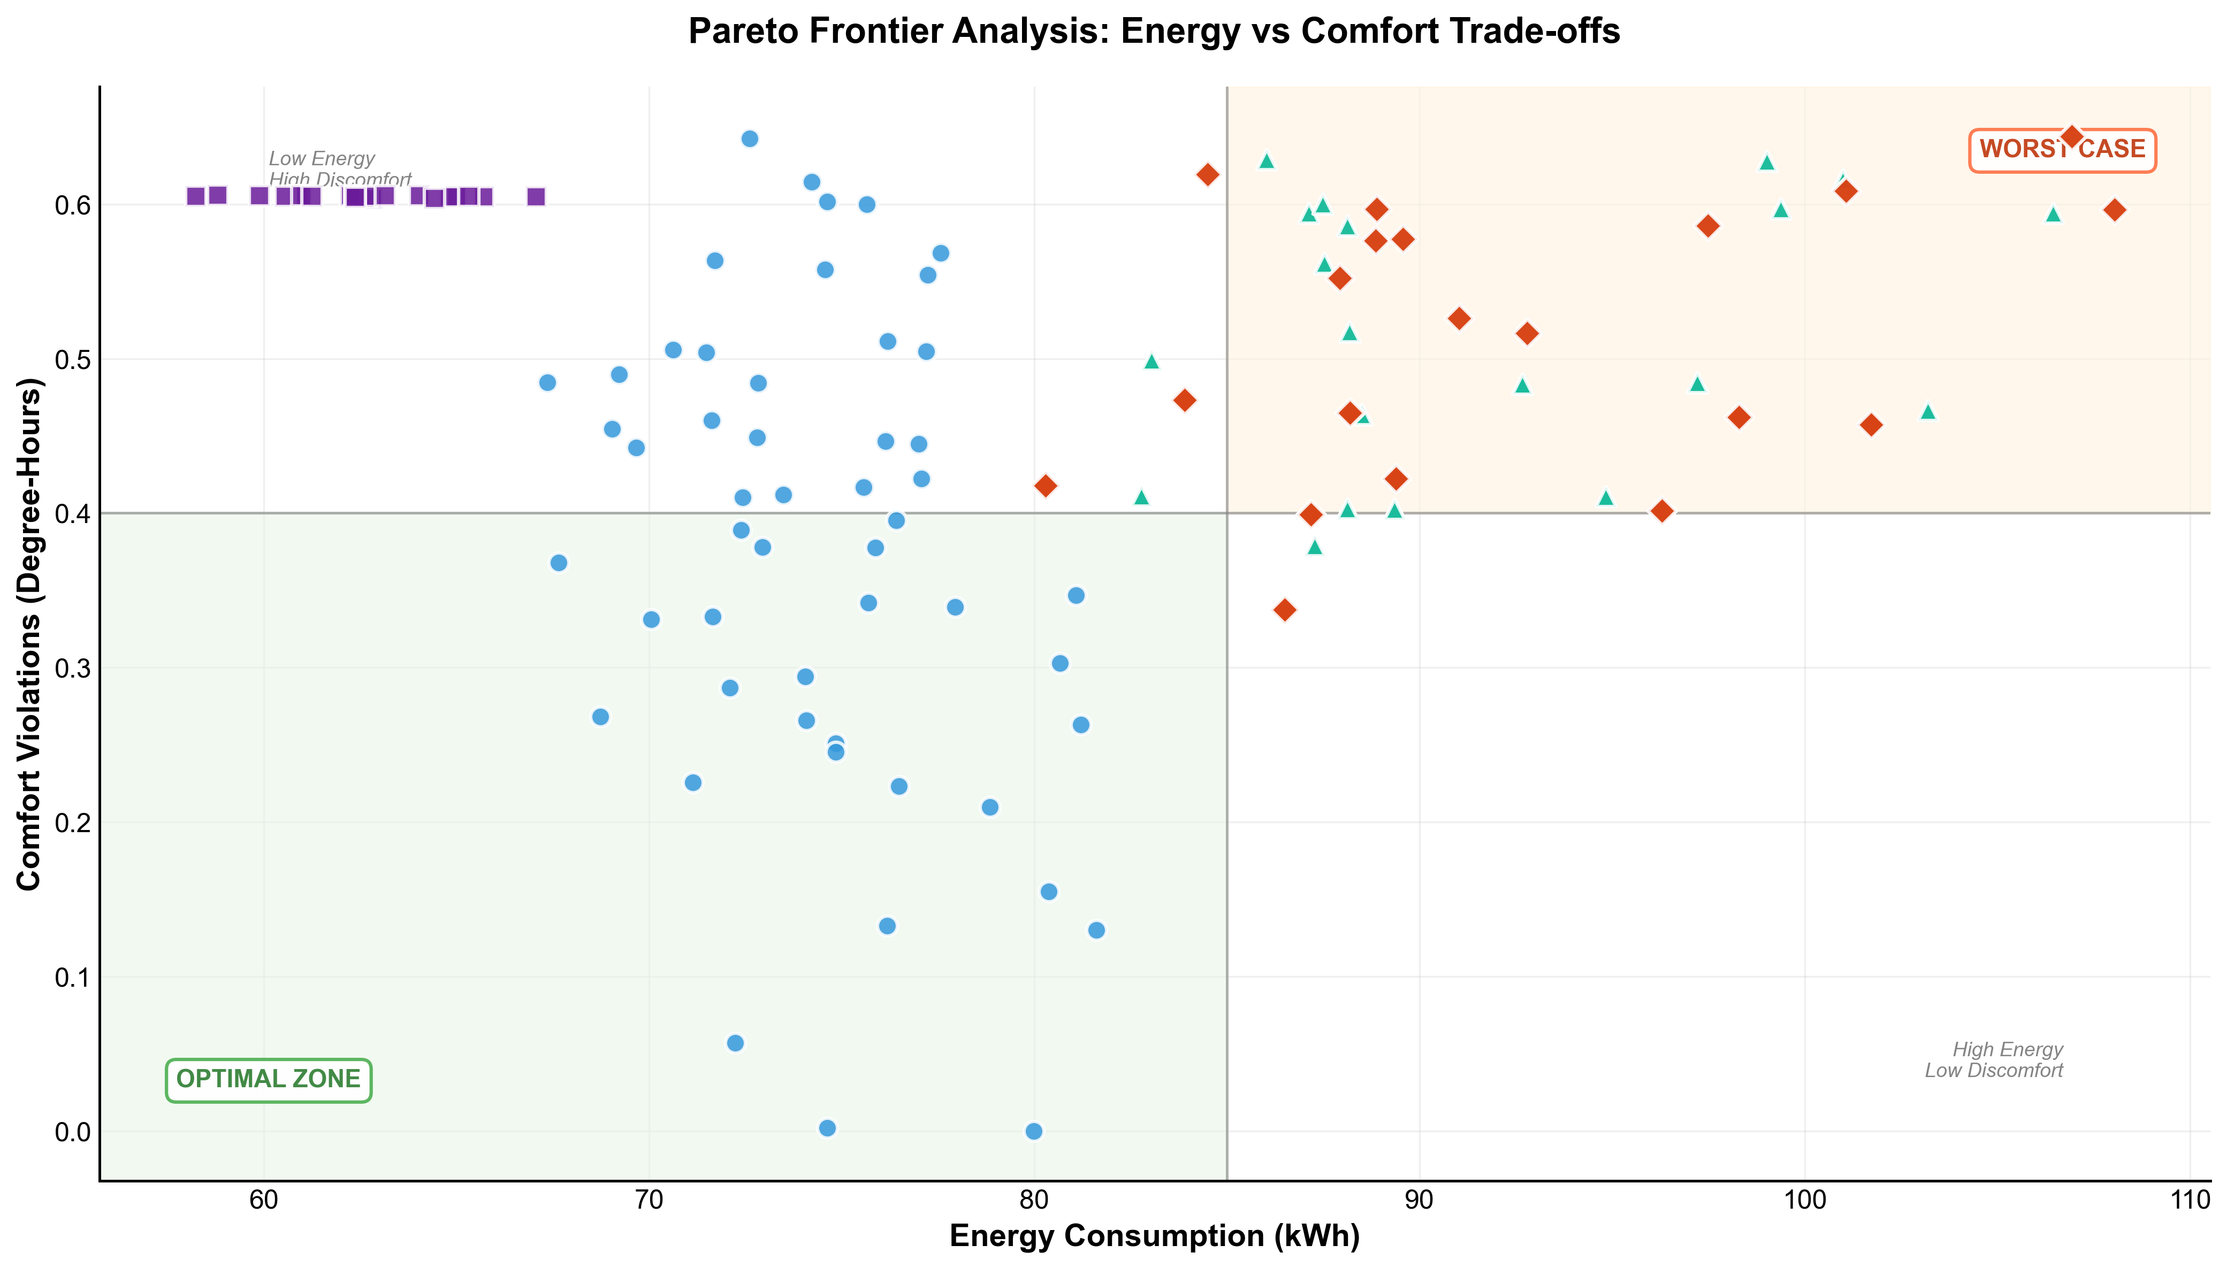
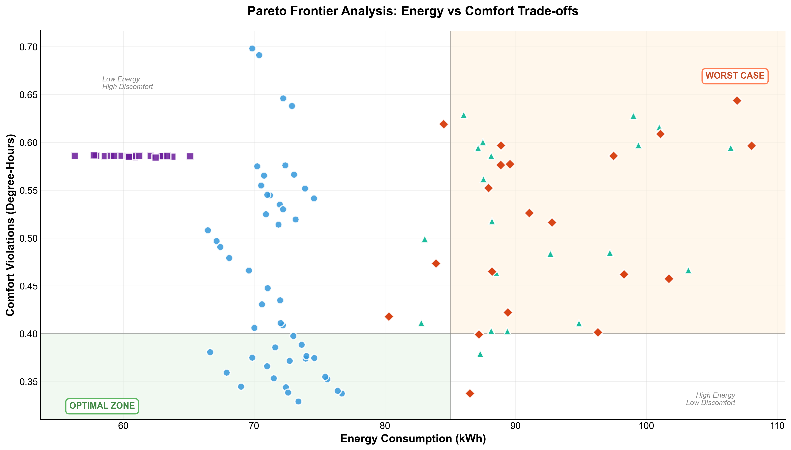
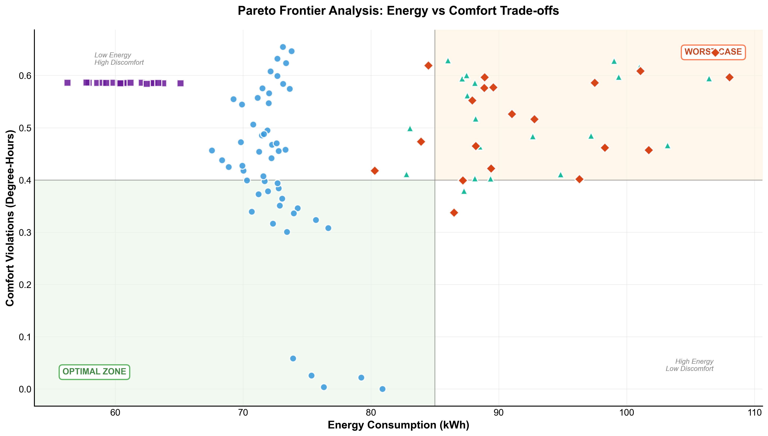
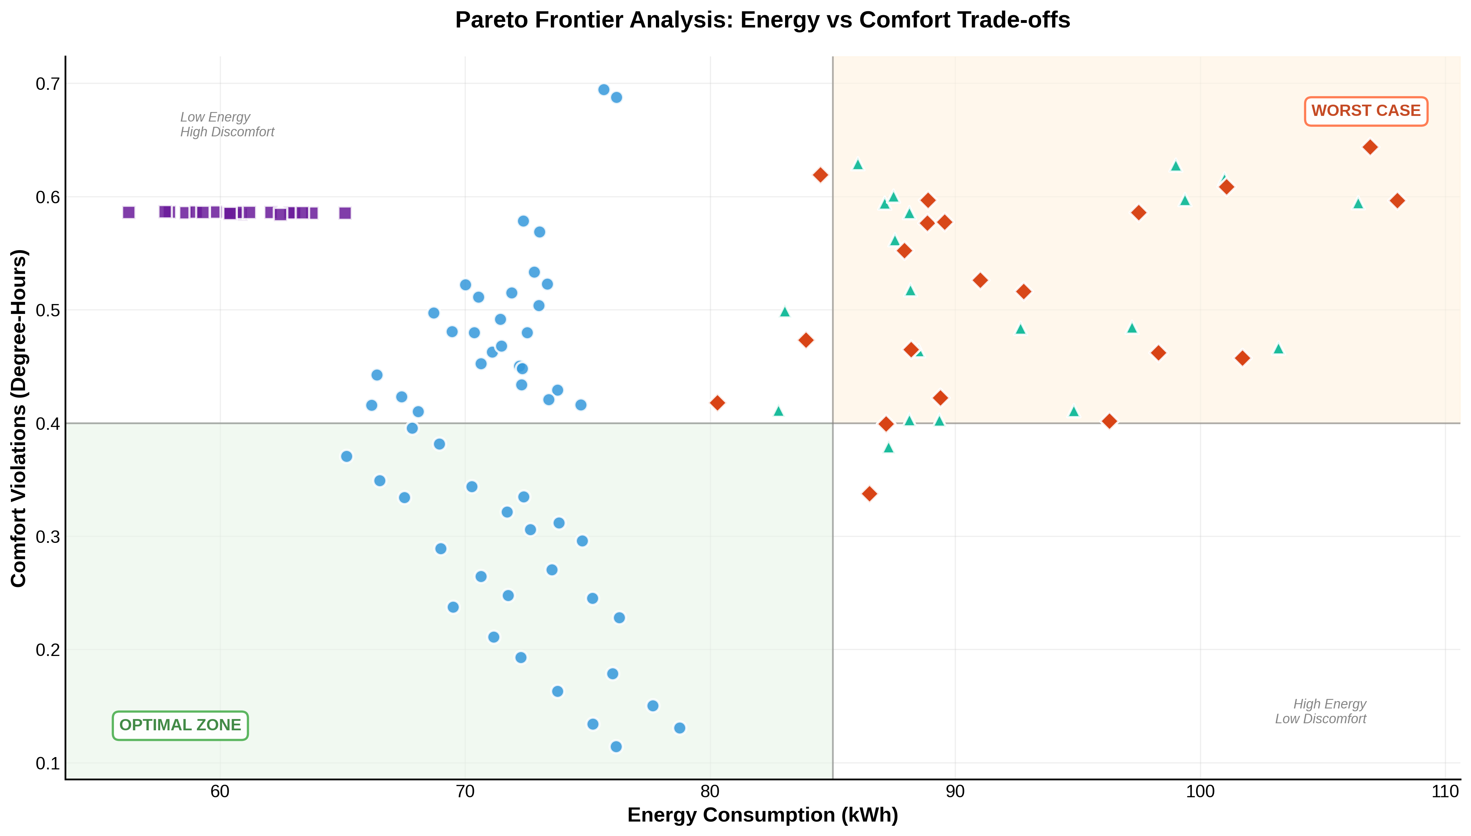
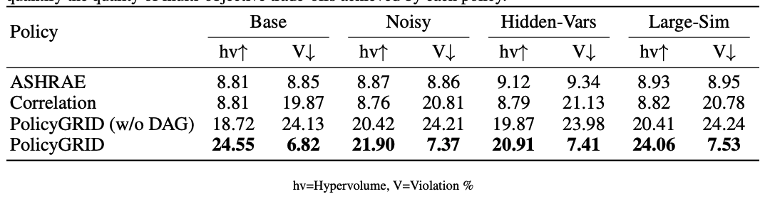
Results: Policy Performance
Highest hypervolume and lowest violation rates with PolicyGRID
Causal DAG critical for policy quality
Baselines (PID, Correlation) show low hv and high violations
PolicyGRID dominates Pareto front with low energy and low discomfort
Notes:
We evaluated four controllers: ASHRAE-PID, Correlation-based, POLICYGRID without causal
DAG, and full POLICYGRID on the Base, Noisy, Hidden-Variable, and Large-Sim setups. Table 2
reports two primary metrics: hypervolume (hv), which summarizes the area of the Pareto front over energy and comfort trade-offs (higher values indicate better trade-offs), and violation rate (V%),
defined as the percentage of time comfort bounds are exceeded (lower values are preferred).
Across all setups, POLICYGRID obtains the highest hypervolume and the lowest violation rates.
Removing the causal DAG leads to lower hypervolume and higher violation rates, showing the
importance of causal structure for policy quality. Both ASHRAE-PID and Correlation baselines
remain below 10 hv and exhibit higher violations.
Figure 3 and 4 illustrate Pareto frontier points across controllers. POLICYGRID consistently
places operating points in the low energy, low comfort violation region. Even at its least favorable
configurations, its comfort violation levels remain below those of the best baselines. ASHRAE-PID
and Correlation cluster in the high-energy, high-discomfort regime, while the DAG ablation tends to
reduce energy at the cost of high comfort violations.

Slide 23
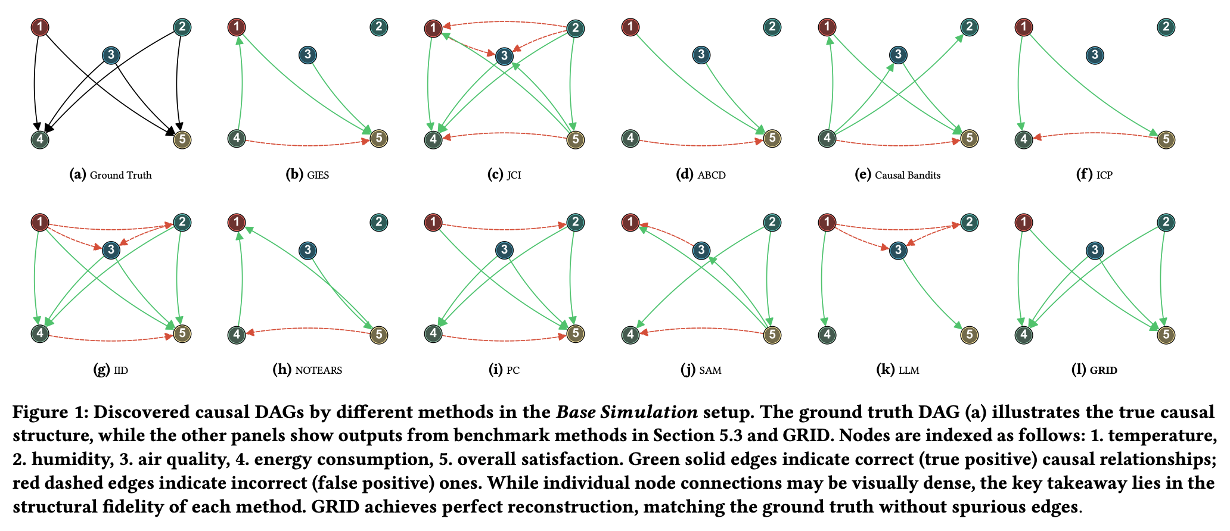
Looking Ahead
Cycles in causal structures like BMS
Scalability of causal discovery
Reliability via uncertainty-aware inference and real-world deployments
Adaptation with online updates and continual (temporal) causal learning
Broader applications in robotics, transport, assistive tech, and other multi-objective control domains

